Slide 1
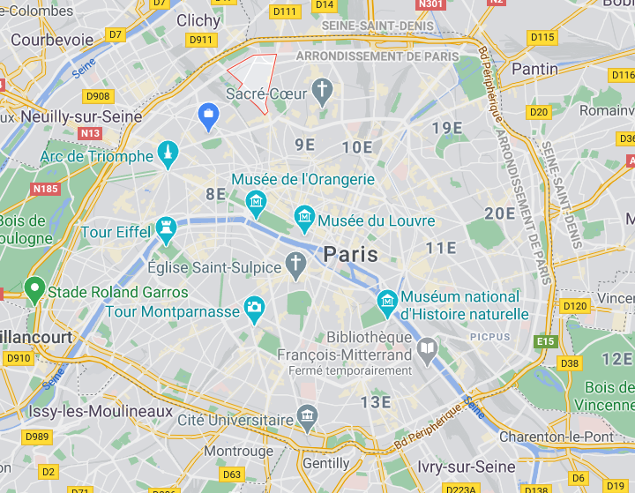
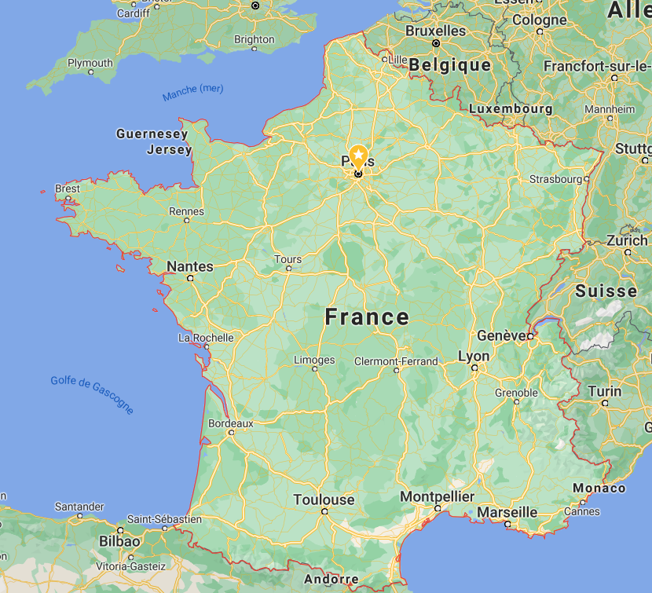
BUSINESS PROBLEM Where to move out?
WHERE TO MOVE OUT?
Assume you are leaving in a neighborhood
You enjoy living in this place & its way of life
But you want to move out for whatever reason:
Want to buy your first home
Looking for a bigger house
Looking for cheaper real estate prices
Looking for somewhere closer to your new job…
You are looking for a list of neighborhoods similar to yours with their real estates prices
Here we will assume you are living in the Epinettes in Paris for example, & you are ready to move to another neighborhood in Paris, Bordeaux or Toulouse
We will provide:
List of neighborhoods from those 3 cities that are similar to the Epinettes based on their venues
Their top 5 most common venues
Their real estate prices
?
?
?
?

Slide 2
METHODOLOGY & DATA SOURCES
GET THE LIST OF NEIGHBORHOODS FOR THE 3 CITIES & THEIR COORDINATES
After some data mining I have been able to find open source data for Paris & Toulouse neighborhoods
As for Bordeaux I had to go on google maps to get the coordinates & create an excel database
Source « quartier_paris.csv »: https://www.data.gouv.fr/fr/datasets/recensement-population-2013-grands-quartiers-population/
Source « quartier_toulouse.csv »: https://data.toulouse-metropole.fr/explore/dataset/recensement-population-2016-grands-quartiers-diplomes/information/
Source: « quartier_bordeaux.xslx »: from google maps
154 neighborhood in our data: 80 in Paris, 60 in Toulouse, 14 in Bordeaux
GET THE REAL-ESTATE PRICE FOR EACH NEIGHBORHOOD
Open source data available with all real estate transactions for 2019: database of 50012 transactions for our 3 cities
Source « 31.csv », « 75.csv », « 33.csv »: https://cadastre.data.gouv.fr/data/etalab-dvf/latest/csv/2019/
Prices have slightly increased in 2020 in those 3 cities but it is marginal
Filter the « exotic » or « luxury » properties & get an average price/m2 for each neighborhood
COMPARE & CLUSTER THE NEIGHBORHOODS BASED ON THEIR VENUES
Get the venues for each neighborhood
Source: Foursquare API
Get the 5 most common venue categories for each neighborhood
Cluster the neighborhoods using kmeans clustering
→ Result: list of neighborhoods from the same cluster with their 5 most common venue categories & their real estate price

Slide 3
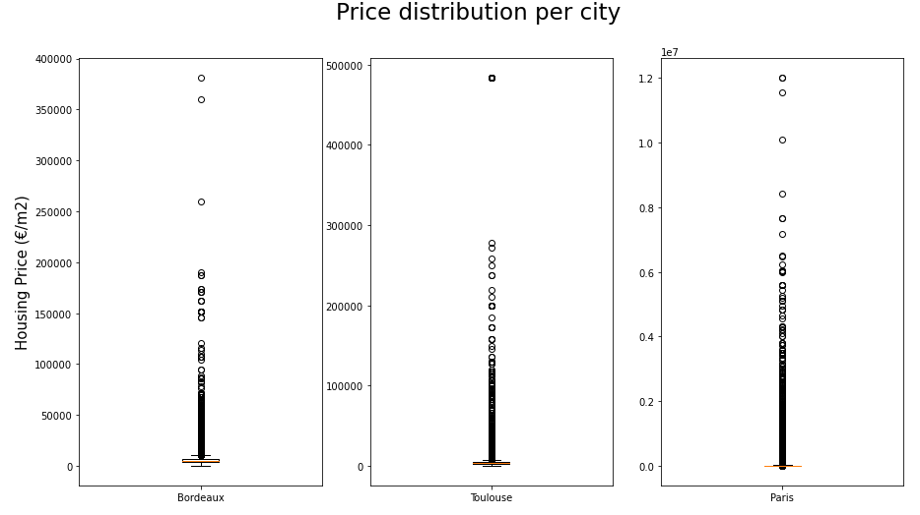
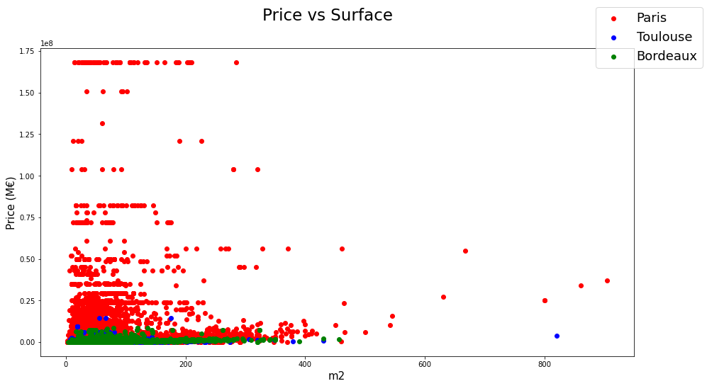
→ We will remove the outliers as we are not interested in extraordinary transactions → We don’t want them to impact our results
REAL ESTATE PRICE DISTRIBUTION PER CITY
We can’t really observe a trend when looking at
price vs surface…
… Because there are a lot of outliers – luxury properties with a very high price/m2

Slide 4
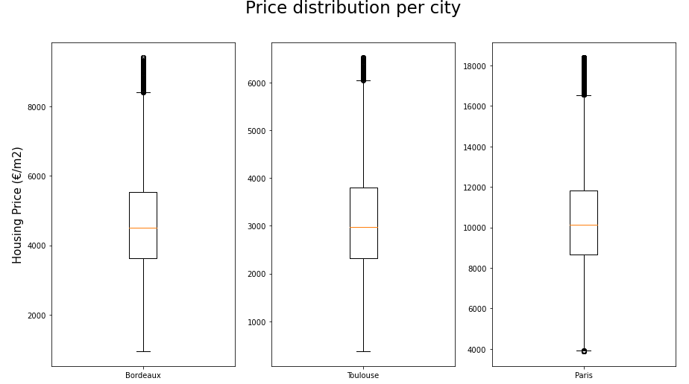
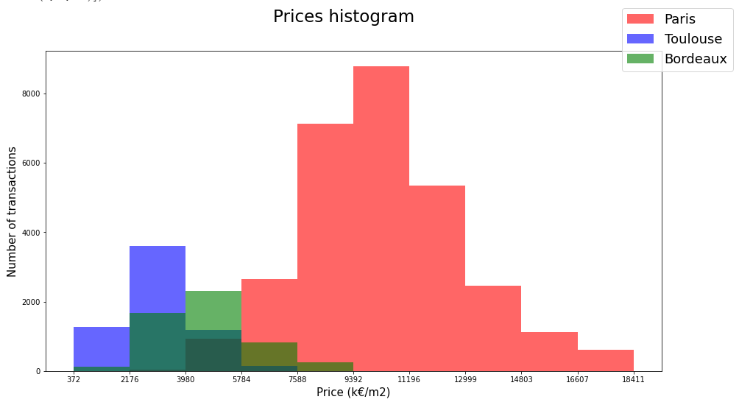
PRICE DISTRIBUTION PER CITY AFTER OUTLIERS REMOVAL
Dataset reduced from 50012 to 40435 transactions

Slide 5
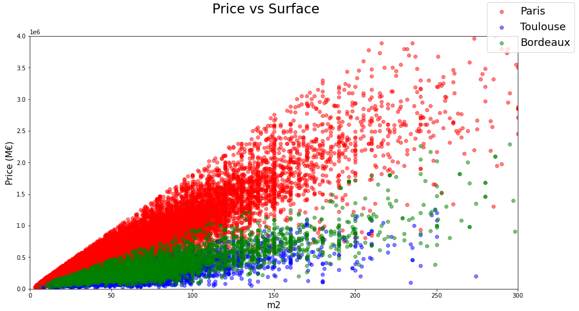
PRICE VS SURFACE – TRANSACTIONS FILTERED
We can now observe expected trends – Dataset ready to be used
Price increase linearly with surface once « exotic » properties have been removed
Paris is more expensive than Bordeaux & Toulouse
For a given surface there is still a price spread for each city depending on the neighborhood

Slide 6
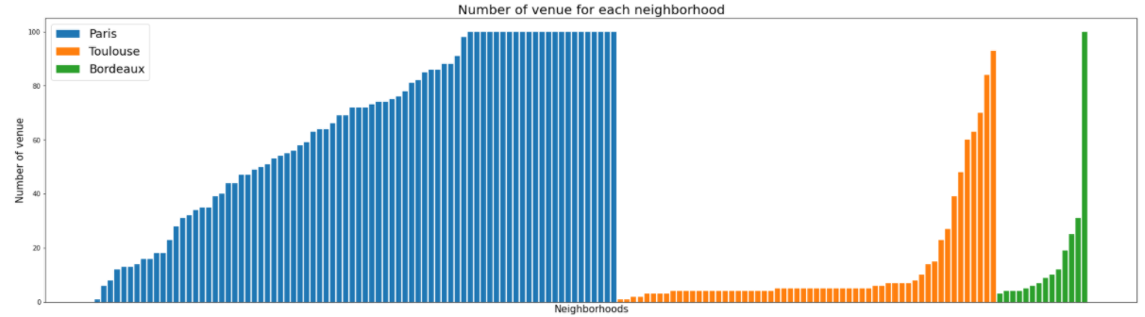
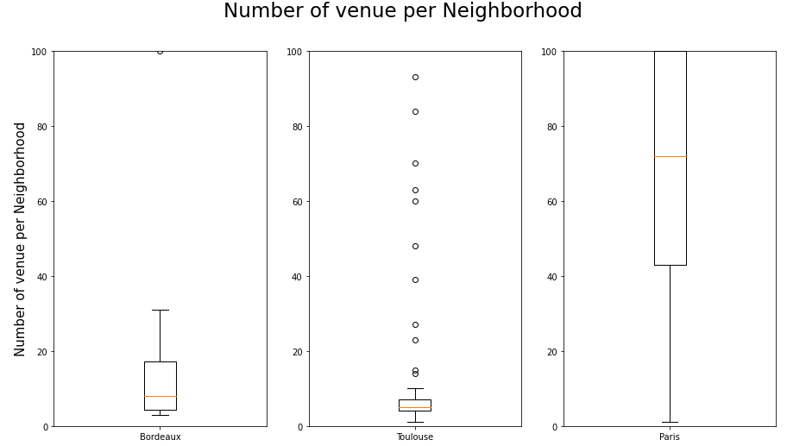
Distribution of number of venues per neighborhood
Foursquare request:
Venues in a radius of 500m for each neighborhoods
Max 100 venues per neighborhoods
6236 venues for Paris, Toulouse & Bordeaux
Distribution are very different:
Several neighborhoods in Paris have more than 100 venues referenced under Foursquare
Many neighborhoods from Bordeaux & Toulouse have a small number of Foursquare referenced venues

Slide 7
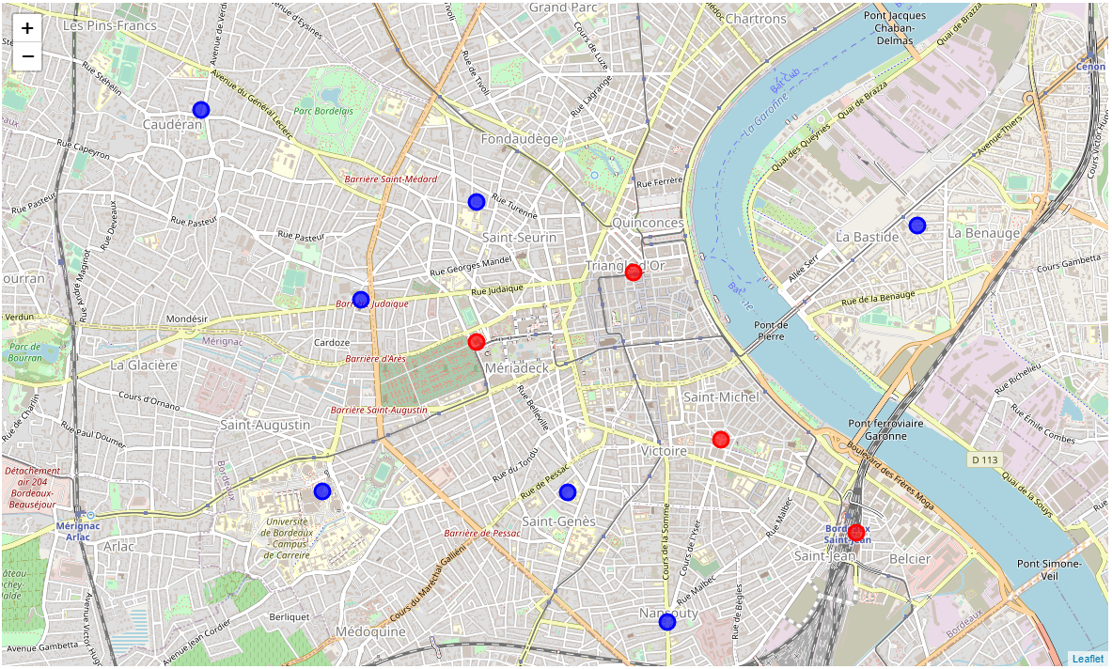
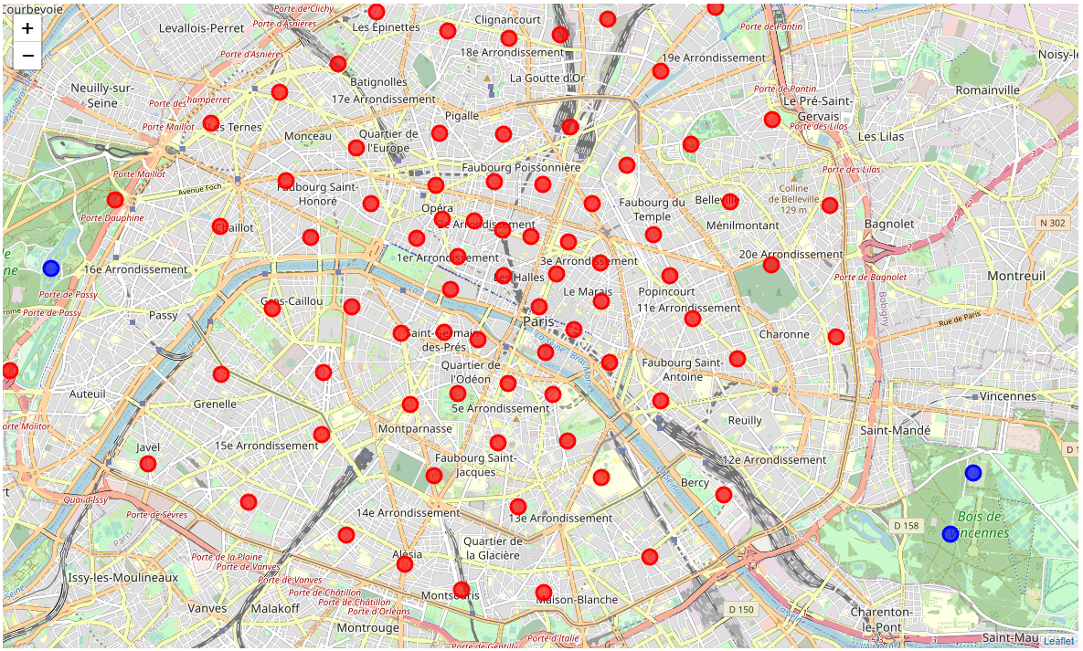
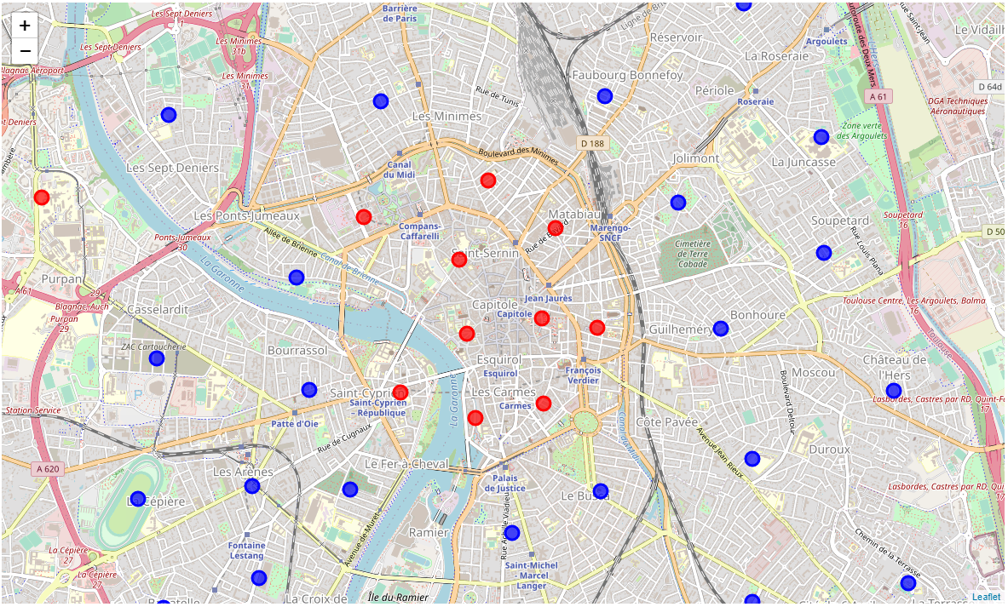
Number of venues per neighborhood Map display
>10 venues
<10 venues
Paris
Bordeaux
Toulouse
Higger density of venues in city centers
Paris « intra-muros » can be considered as one huge city center
Some neighborhoods from Bordeaux or Toulouse are essentially residential
But there is also a bias: higher proportion of venues referenced under Forsquare in Paris than in Toulouse or Bordeaux: Paris is the capital, more touristic, more international, more cosmopolitan

Slide 8
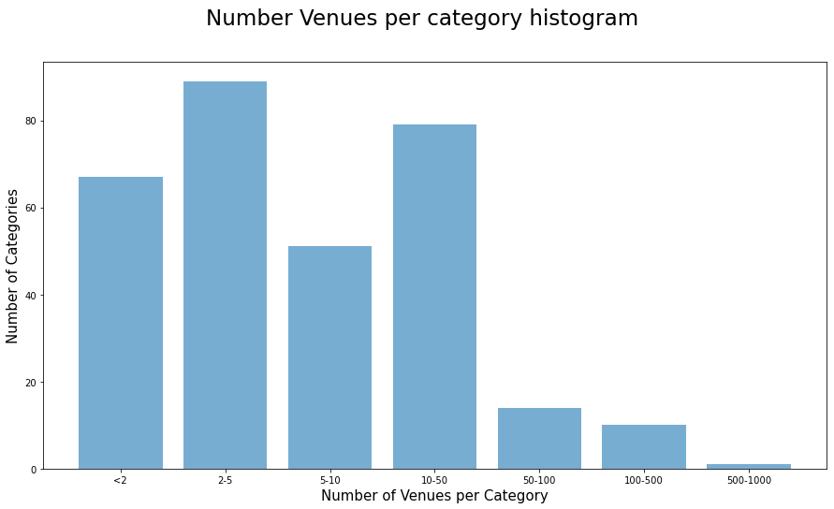
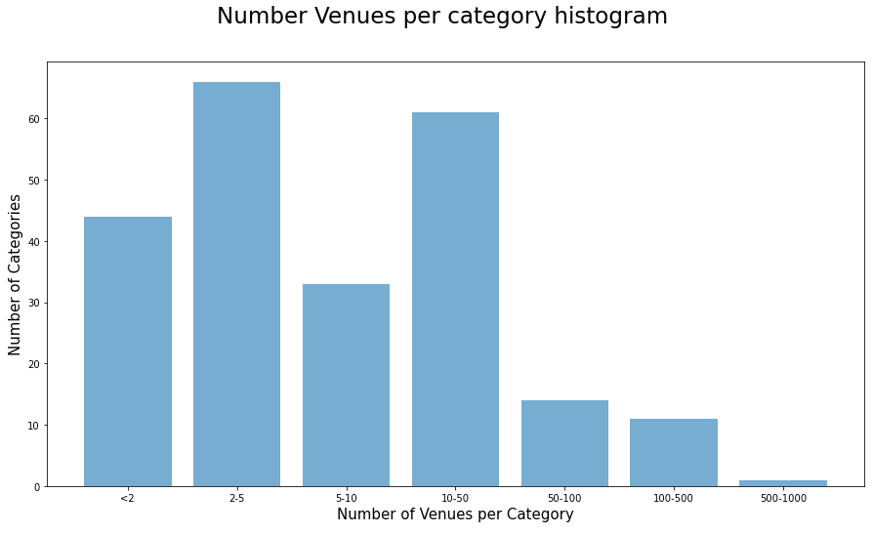
Data preparation for kmeans clustering
Filter: Remove neighborhoods with less than 10 venues from Foursquare Request
Either they are not representative: not enough venues to characterise the neighborhood
Or there is actually a very small number of venues & in this case we are not interested in those to move in
Number of neighborhoods down from 154 to 93
Number of venues down from 6236 to 5954
60% of neighborhoods concentrates 95% of the Foursquare request results
There are 319 different categories of venue
87 of them are different types of restaurant → this is too much detailed & some similar restaurant may fall in different categories if they have been described slightly differently
We reduce the restaurant categories to 9
→ Number of different categories down to 239
Grouping
Some
Categories

Slide 9
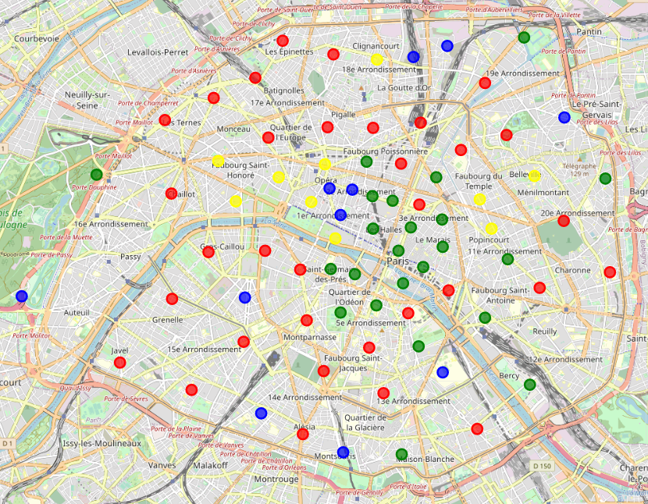
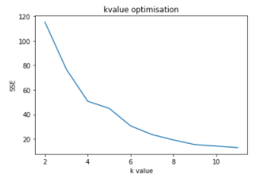
Kmeans clustering
K=4 is the optimised value for clustering
Paris example: each color is a different cluster

Slide 10
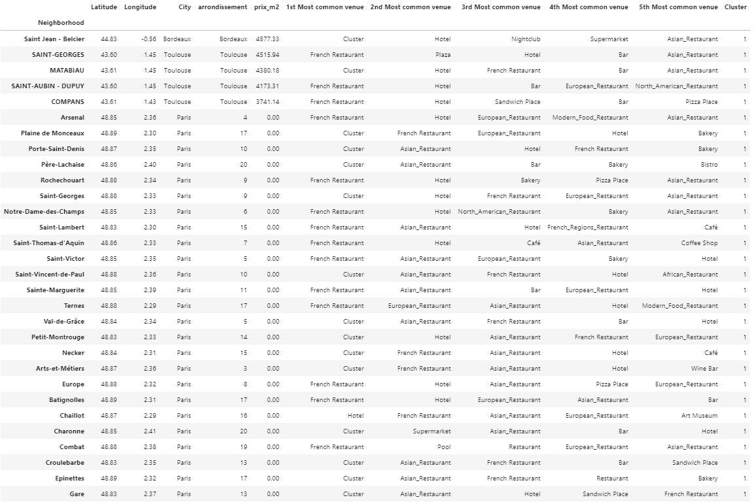
Result with k = 4 The list is quite long – lets run with more clusters

Slide 11
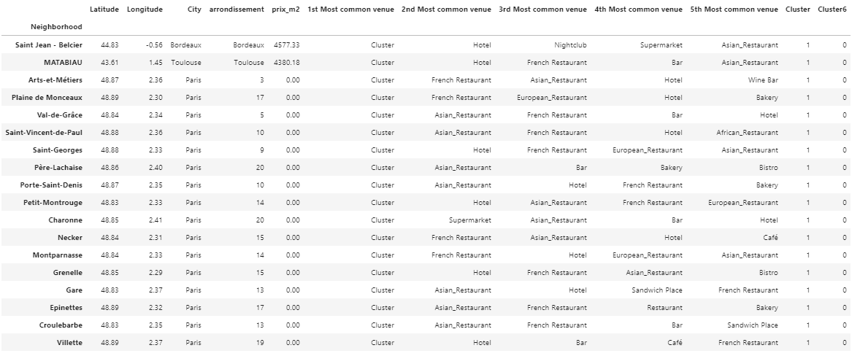
Where to move if you want to leave the Epinettes And what are the real estate prices

